Slide 1
Velocity Music System The Soundtrack to Your Life Walt R Bender
Copyright 2021

Slide 2
Velocity Music System
Mission Statement: Vitality Music System strives to be the most effective music-activity pairing application for a mobile device on the market.
Copyright 2021

Slide 3
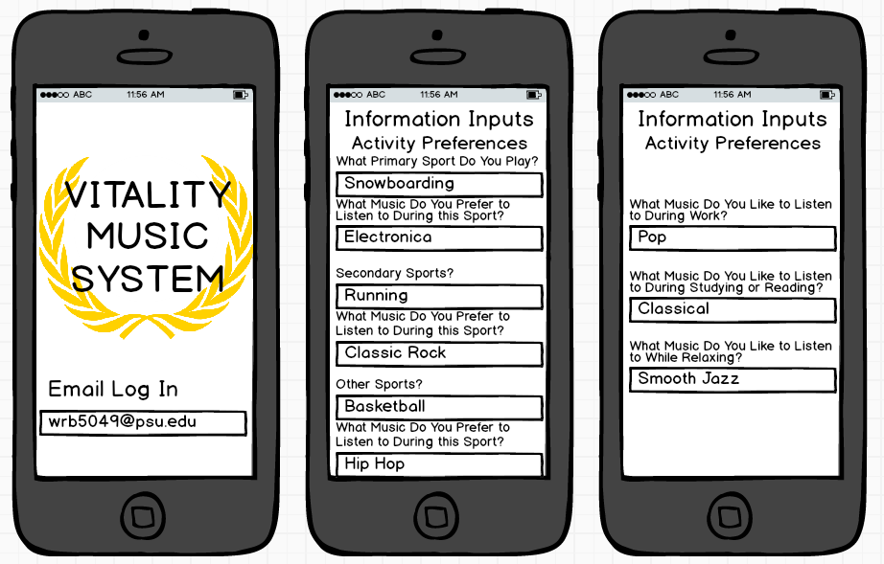
HOW IT WORKS
Copyright 2021

Slide 4
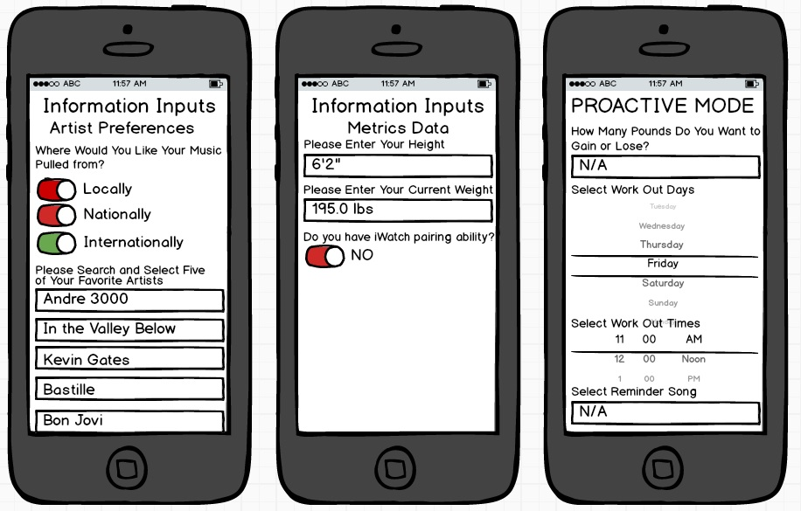
HOW IT WORKS
Copyright 2021

Slide 5
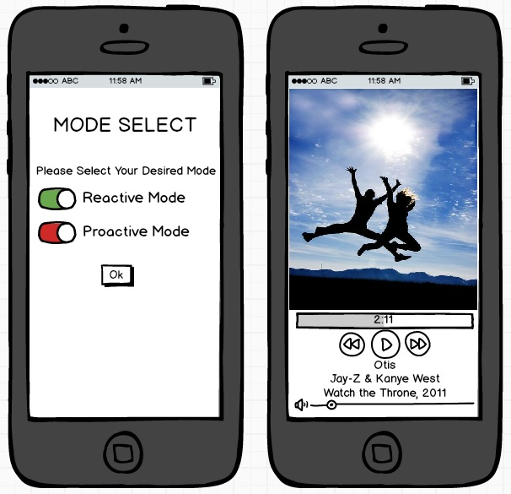
HOW IT WORKS
Copyright 2021

Slide 6
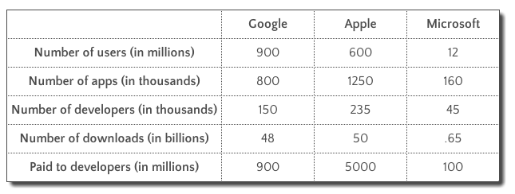
Marketability & Industry Analysis
 | Threat of Industry Profitability
Competitive Force | Low | Medium | High
Threat of Substitutes | ●
Threat of New Entrants |  | ●
Rivalry Among Existing Firms | ●
Bargaining Power of Suppliers | ●
Bargaining Power of Buyers | ●
Forbes data
$65,835 Otreva.com
$89,905 Kinvey.com
$29,800 Howmuchtomakeanapp.com
Copyright 2021

Slide 7
Financial Estimates
Pro Forma | Net Sales | App Store 30% | Cost of Sales | Gross Profit | SGA | EBITDA
Year 1 Projected | $10,000 | $3,000 | $50,000 | ($43,000) | $100 | ($43,100)
Year 2 Projected | $20,000 | $6,000 | $0 | $14,000 | $100 | $13,900
Year 3 Projected | $40,000 | $12,000 | $0 | $28,000 | $100 | $27,900
Year 4 Projected | $80,000 | $24,000 | $0 | $56,000 | $100 | $55,900
Year 5 Projected | $100,000 | $30,000 | $0 | $70,000 | $100 | $69,900
5-Year End | $250,000 | $75,000 | $50,000 | $125,000 | $500 | $124,500
Copyright 2021

